Slide 1
Radix-Sort
Non-comparison based sorting

Slide 2

Radix-Sort
Previous discussion of sorting asserts any comparison-based sorting algorithm is
So can we do better?
Have to do it without comparisons.

Slide 3
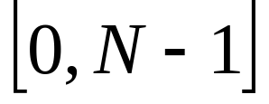
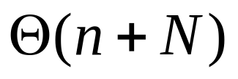
Radix-Sort
Given a range
and a finite set of n numbers, from that range
It is possible to sort those n numbers in time. O(n) for a given N.

Slide 4
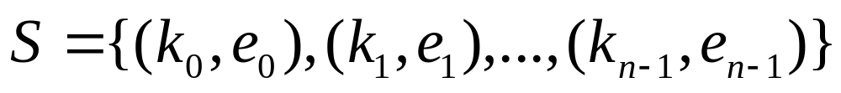
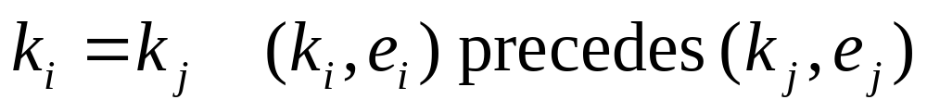
Stable Sorting
Consider any sorting algorithm:
  Let S denote a sequence of n key, element pairs
  If
    Before sorting:
      AND
    After Sorting:
  Then
    We say that the sorting algorithm is stable.
    Similar keys maintain the same relative position to each other after sorting by a stable sorting algorithm!

Slide 5
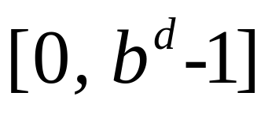
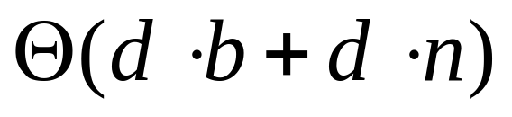
Radix-Sort
Common bases:
  b=16 → hexidecimal {0,1,…,9,A,B,C,D,E,F}
  b=10 → decimal {0,1,2,3,4,5,6,7,8,9}
  b=8 → octal {0,1,2,3,4,5,6,7}
  b=2 → binary {0,1}
Numbers are represented in base b;
(radix b)
n numbers in the range .
That is, n has d digits in base b.
We can sort in

Slide 6
Radix-Sort
Using Base b
  Use b “buckets”
  The buckets are stable. Items go in the same order they come out (FIFO).
  Starting with least significant digit place each item to be sorted into their appropriate bucket.
  Re-assemble the numbers by emptying the buckets, in order of course
  Move to the next significant digit place and repeat the whole process. Repeat for each of the d digits used to represent your numbers.

Slide 7
Radix-Sort
Example: (radix 10)
  Sort following numbers in ascending order
  {164, 37, 395, 12, 9, 982, 733, 112, 428, 377, 55}
1 | 6 | 4
0 | 3 | 7
3 | 9 | 5
0 | 1 | 2
0 | 0 | 9
9 | 8 | 2
7 | 3 | 3
1 | 1 | 2
4 | 2 | 8
3 | 7 | 7
0 | 5 | 5
0 | 1 | 2
9 | 8 | 2
1 | 1 | 2
7 | 3 | 3
1 | 6 | 4
3 | 9 | 5
0 | 5 | 5
0 | 3 | 7
3 | 7 | 7
4 | 2 | 8
0 | 0 | 9
0 | 0 | 9
0 | 1 | 2
1 | 1 | 2
4 | 2 | 8
7 | 3 | 3
0 | 3 | 7
0 | 5 | 5
1 | 6 | 4
3 | 7 | 7
9 | 8 | 2
3 | 9 | 5
0 | 0 | 9
0 | 1 | 2
0 | 3 | 7
0 | 5 | 5
1 | 1 | 2
1 | 6 | 4
3 | 7 | 7
3 | 9 | 5
4 | 2 | 8
7 | 3 | 3
9 | 8 | 2
key=n%10
key=(n/10)%10
key=(n/100)%10

Slide 8
Graph Theory
Connect the dots

Slide 9
Graphs
Definitions
Graph Data Structures
Searching/ Traversal

Slide 10
Application Areas
Many many application areas, including:
  Electronic Circuits
  Mapping / Geographic Information Systems
  Network Representation
    LAN/WAN etc
    Social Networks
    Transportation Networks
      Roads
      Airways
      Railways

Slide 11
Graph Definition
A Graph, G=(V, E), is composed of:
  V: A set of vertices
  E: A set of edges connecting the vertices in V
An edge e = (u, v) is a pair of vertices.

Slide 12
Undirected Graph
Undirected Graph
  Pairs of vertices are unordered: (u, v) = (v, u)
  V = {a, b , c, d, e}
  E = {(a, c), (b, c), (e, c), (d, c), (b, e)}
a
b
c
d
e

Slide 13
Directed Graph
Also known as a “digraph”.
Pairs of vertices are ordered: (u, v) ≠ (v, u)
The edge (u, v) is said to be from u to v
V = {a, b, c, d, e}
E = {(a, c), (c, a), (c, b), (b, e), (e, c), (d, c)}
a
b
c
d
e

Slide 14
Vertices and Edges
Vertices
  Vertices u and v are the endpoints of the edge (u, v)
  v is adjacent to u if there is an edge (u, v) from u to v.
Edges
  The undirected edge (u, v) is incident on vertices u and v
  The directed edge (u, v) is:
    incident on vertex v
    an outgoing edge of vertex u
    an incoming edge of vertex v

Slide 15
Degree
in-degree of v
  The number of incoming edges of v
out-degree of v
  The number of outgoing edges of v \
Degree of v
  Undirected graph: Number of edges incident on it. (Degree(c) = 4.)
  Directed graph: degree = in-degree of v + out-degree of v. (Degree(c) =5.)
a
b
c
d
e
a
b
c
d
e

Slide 16
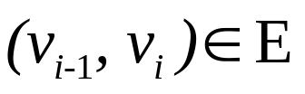
Paths
A path of length k from v₀ to v_{k} in a graph G=(V, E) is a sequence of vertices (v₀ v₁ … v_{k}) such that for i = 1,…, k.
Undirected graph:
(d c b e)
(a c e b c d)
Directed graph:
(a c b e)
(b e c a c d)
A cycle is a path such that the last vertex is the same as the first vertex
a
b
c
d
e
a
b
c
d
e

Slide 17
Data Structures for Graphs
We have a graph. How can we represent it?
To start with, we store the vertices and the edges into two containers, and we store with each edge object, references to its end vertices.
Additional structures can be used to perform efficiently the methods of the Graph ADT.

Slide 18
Euler and the Bridges of Koenigsberg
C
Pregal River
A
D
B
Imagine yourself as a traveling salesperson; you want to reach A, B , C and D (finishing at your starting point) without backtracking.
Can you walk across each bridge exactly once and return at the starting point?
In 1736, Euler proved that this is not possible.

Slide 19
Correction
C
A
D
B
Euler Tour:
  path that traverses every edge exactly once and returns to the first vertex
Euler’s Theorem:
  A graph G has a Euler Tour if and only if degree(v) is even for every vertex v of G.
  If start ≠ end, start and end verticies are allowed to be odd

Slide 20
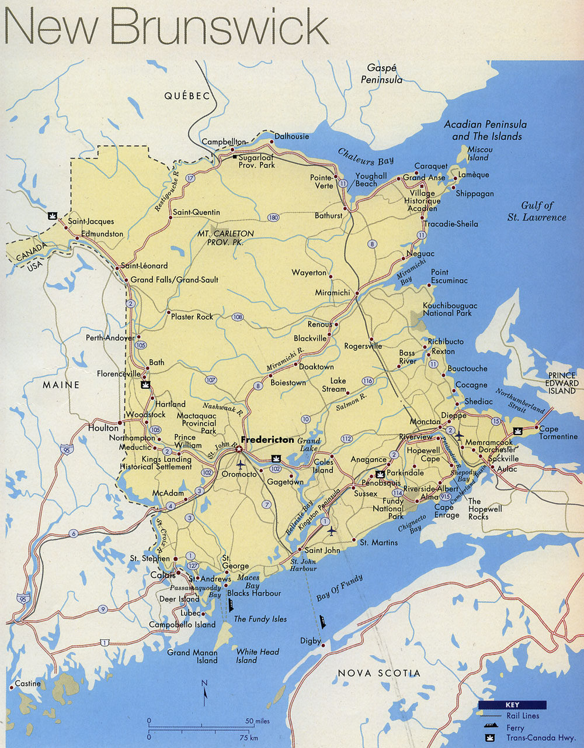
Ba
Ed
GF
Mi
Mo
Fr
SJ

Slide 21
220
Ba
Ed
81
62
202
GF
Mi
141
192
165
360
Mo
Fr
150
111
SJ

Slide 22
Edge List
The edge list structure simply stores the vertices and the edges into unsorted sequences.
Easy to implement.
  Finding the edges incident on a given vertex is inefficient since it requires examining the entire edge sequence
62
220
202
81
192
165
360
111
150
141
Ed
GF
Ba
Mi
Fr
SJ
Mo

Slide 23
Adjacency List
(Traditional approach)
Undirected graph: For each vertex v, store the list of adjacent vertices of v
Directed graph: For each vertex v, store the list of outgoing edges of v
C
A
B
C
D
B
A
D
A
D
C
A
D
B
D
B
C
A

Slide 24
Adjacency List
(Traditional approach)
C
A list of lists
A
D
B
Undirected | Directed
A = ((A,B)(A,C)(A,D)) B = ((B,A)(B,D)) C = ((C,A)(C,D)) D = ((D,B)(D,C)(D,A)) | A = ((A,B)(A,C)(A,D)) B = ((B,A)) C = ((C,A)) D = ((D,B)(D,C))

Slide 25
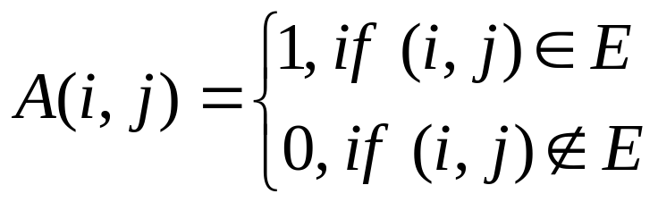
Adjacency Matrix
Let G = (V, E) be a graph with V vertices and E edges.
G can be represented as an n x n matrix as follows:
 | a | b | c | d | e
a | 0 | 0 | 1 | 0 | 0
b | 0 | 0 | 1 | 0 | 1
c | 1 | 1 | 0 | 1 | 1
d | 0 | 0 | 1 | 0 | 0
e | 0 | 1 | 1 | 0 | 0
 | a | b | c | d | e
a | 0 | 0 | 1 | 0 | 0
b | 0 | 0 | 0 | 0 | 1
c | 1 | 1 | 0 | 0 | 0
d | 0 | 0 | 1 | 0 | 0
e | 0 | 0 | 1 | 0 | 0
a
b
c
d
e
Undirected
Directed

Slide 26
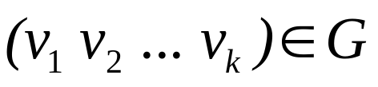
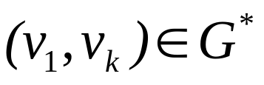
Transitive Closure
Fundamental question:
  Reachability. What is the set of vertices that can be reached by following a path starting from a particular vertex?
  Conversely, are there any vertices that cannot be reached from a particular vertex?
The transitive closure of a digraph G = (V, E) is a digraph G* = (V, E*), if, for every directed path , there is an edge .
That is, G* has the same vertices as G, and G* has an edge (u, v) whenever G has a directed path from u to v.

Slide 27
Transitive Closure
The Floyd Warshall Algorithm for computing the transitive closure of G.
Algorithm FloydWarshall(G)
Input: A digraph G with n vertices.
Output: The transitive closure G* of G
Let v₁, v₂, ..., v_{n}, be an arbitrary numbering of the vertices of G.
G₀ = G
for k=1 to n do{
for
if (both edges (v_{i},v_{k}) and (v_{k},v_{j}) are in G_{k-1}) {
add edge (v_{i},v_{j}) to G_{k}
}}}
return G_{n}

Slide 28
Floyd-Warshall - Java Code Segment
n = adj.length //adj as an adjacency matrix
for (k=0; k<n; k++){
for (i=0; i<n; i++){
for (j=0; j<n; j++){
if (j != i && adj[i][j]==0 && adj[i][k]==1 && adj[k][j]==1){
adj[i][j] = 1;
}
}
}

Slide 29
Floyd-Warshall - Example
 | a | b | c | d | e
a | 0 | 0 | 1 | 0 | 1
b | 1 | 0 | 0 | 0 | 0
c | 0 | 0 | 0 | 1 | 0
d | 0 | 1 | 0 | 0 | 0
e | 0 | 0 | 0 | 1 | 0
b
a
c
d
K=1 (b)
K=3 (d)
K=0 (a)
K=2 (c)
K=4 (e)
e

Slide 30
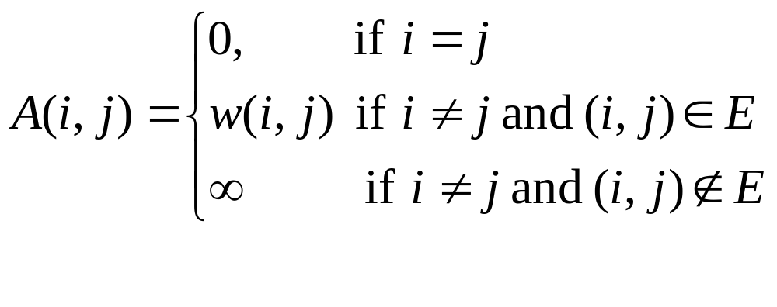
Weighted Graphs
Let G = (V, E) be a graph with V vertices and E edges.
Each edge (u, v) has an associated cost, w(u, v) ≠ 0.
G can now be represented as an n x n matrix as follows:
Adjacency matrix with costs
 | a | b | c | d | e
a | 0 | ∞ | 3 | ∞ | ∞
b | ∞ | 0 | ∞ | ∞ | 17
c | 1 | 22 | 0 | ∞ | ∞
d | ∞ | ∞ | 5 | 0 | ∞
e | ∞ | ∞ | 9 | ∞ | 0
a
b
1
22
3
c
17
9
d
5
e

Slide 31
All Pairs Shortest Path
Floyd’s Algorithm
a
b
1
8
n = adjw.length;
for (i = 0; i < n; j++) {
for (j = 0; j < n; j++) {
path [i][j] = -1; } }
for (k = 0; k < n; k++) {
for (i = 0; i < n; i++) {
for (j = 0; j < n; j++) {
if ( adjw[i][k] + adjw[k][j] < path[i][j]){
adjw[i][j] = adjw[i][k] + adjw[k][j]
pathh[i][j]=k
3
c
17
6
d
5
e
19
 | a | b | c | d | e
a | 0 | ∞ | 3 | ∞ | ∞
b | ∞ | 0 | ∞ | ∞ | ∞
c | 1 | 8 | 0 | ∞ | ∞
d | ∞ | 19 | 5 | 0 | ∞
e | ∞ | 17 | 6 | ∞ | 0
 | a | b | c | d | e
a | 0 | ∞ | 3 | ∞ | ∞
b | ∞ | 0 | ∞ | ∞ | ∞
c | 1 | 8 | 0 | ∞ | ∞
d | ∞ | 13 | 5 | 0 | ∞
e | ∞ | 14 | 6 | ∞ | 0
 | a | b | c | d | e
a
b
c
d |  | 2
e |  | 2

Slide 32
Graph Traversals
Depth-First Search
  Exploring a labyrinth without getting lost.
    The milk run. Tours through the graph looking for node.
    Only backtracks when no other unvisited node is found
Breadth-First Search
    Finds shortest path.
    Uses back-tracking to examine all local possibilities beofre choosing one of those possibilities to pursue further.

Slide 33
Exploring a Labyrinth Without getting lost
A depth-first search (DFS) in an undirected graph G is like wandering in a labyrinth with a string and a can of red paint without getting lost.
  We start at vertex s, tying the end of our string to the point and painting s “visited”. Next we label s as our current vertex and call it u.
  Now we travel along an arbitrary edge (u, v).
  If edge (u, v) leads us to an already visited vertex v we return
  to u.
  If vertex v is unvisited, we unroll our string and move to v, paint v “visited”, set v as our current vertex, and repeat the previous steps.
  Eventually, we will get to a point where all incident edges on u lead to visited vertices. We then backtrack by unrolling our string to a previously visited vertex v. Then relabel v as our current vertex u and repeat from step 2.
  If there are no more edges to explore, the search is done.

Slide 34
DFS Example
Ba
Ed
GF
Mi
Adjacency list for city graph
Mirimichi to Saint John
Fr
Mo
Ed
GF
SJ
GF
Ed
Ba
Mi
Fr
Ba
GF
Mi
SJ
Mi
Ba
GF
Mo
Fr
Fr
GF
Mi
SJ
Mo
Mi
SJ
SJ
Fr
Ba
Mo
Mi
Ba
GF
Ed
Ba
Mi
Fr
GF
Mi
GF

Slide 35
DFS Example
Ba
Ed
GF
Mi
Adjacency list for city graph
Moncton to Grand-Falls
Fr
Mo
Ed
GF
SJ
GF
Ed
Ba
Mi
Fr
Ba
GF
Mi
SJ
Mi
Ba
GF
Mo
Fr
Fr
GF
Mi
SJ
Mo
Mi
SJ
SJ
Fr
Ba
Mo
Mo
Mi
Ba
GF

Slide 36
Depth-First Search Algorithm
An auxiliary Path class - a very simplified linked list
public class Path {
private Object mFirst;
private Path mRest;
public Path(Object e, Path p) {
mFirst = e;
mRest = p;
}
public Object first() { return mFirst; }
public Path rest() { return mRest; }
} // Path

Slide 37
Depth-First Search Algorithm
Algorithm Depth-First-Search(v, g)
Input: A vertex v and a target vertex g
Output: A path from v to g
Let s be a Stack and p be a path
s.push(new Path(v, null));
while (s is not empty) do {
p= (Path) s.pop()
v = (Vertex) p.first()
v.mark()
if (v equals g) then return p
for each vertex w in v’s adjacency list {
if (w is unexplored) then {
s.push(new Path(w, p))
}
}
}

Slide 38
Breadth-First Search Algorithm
Algorithm Breadth-First-Search(v, g)
Input: A vertex v and a target vertex g
Output: A path from v to g
Let q be a Queue and p be a path
q. enqueue (new Path (v, null));
while (q is not empty) do {
p = (Path) q.dequeue()
v = (Vertex) p.first()
v.mark()
if (v equals g) then return p
for each vertex w in v’s adjacency list do {
if (w is unexplored) then {
q.enqueue(new Path(w, p))
}
}
}

